Slide 1
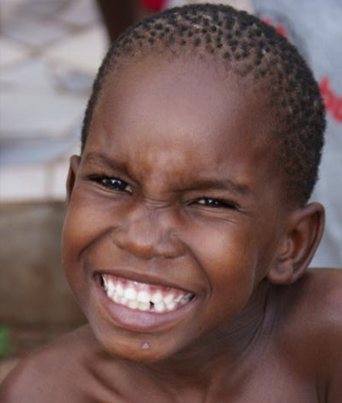
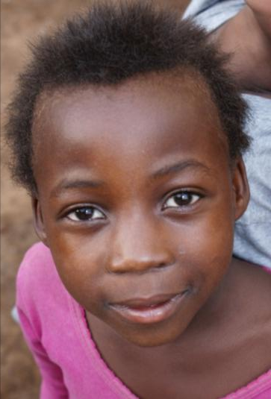
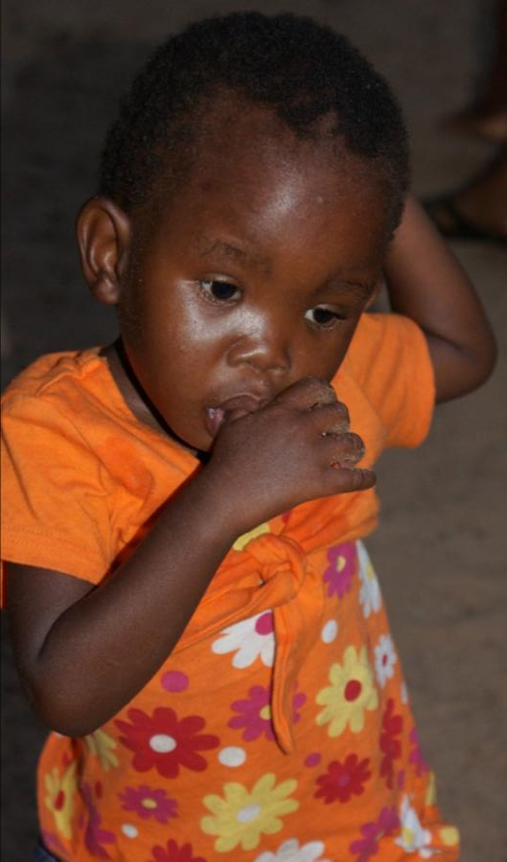
Bana Ba Ditlou
Children of the Elephants
St. Francis of Assisi Catholic Mission
KASANE - BOTSWANA
start here

Slide 2
MENU:
A response of the Catholic Community to the growing problem
of orphaned, hungry, neglected, malnourished, abused,
HIV infected, dying of AIDS
and otherwise vulnerable street children of the town of Kasane.
Why Bana Ba Ditlou?
Vision for BaBaDi
Activities
Facilities
Sponsorship
Donate
Board of the project
Staff
Contact info
Conservation
Images
Wallpapers
Come on Safari
Presentation prepared & sponsored by
Bona Safari Services & Birding Botswana

Slide 3
Why Bana Ba Ditlou?
In the border towns of Kasane and Kazungula and in other villages of Chobe area there are many children who have lost their parents, who have no fathers or have single, often irresponsible young mother; children whose parents have no jobs, who drink in desperation, whose parents die of AIDS, whose parents don't care, or don't know how to care, who abandon their children, who don't give them enough food and clothing, who push their children to become "street-kids" - dodging school or failing in school; children infected with the HIV, children going hungry, frustrated, angry, trying drugs, even being involved in criminal activities and prostitution, being sexually abused ... but constantly seeking love and attention, looking for quality time and dreams of a better future.
Many of those children in need have been visiting our Catholic Mission located in the most socially disadvantaged part of the town called Kgaphamadi. Their growing number seeking some kind of help, attention and meaningful stimulation, with the associated troubles (breaking into our mission facilities, church, toilets, damaging water supply, flowers and landscaping) was a constant reminder of the necessity and urgency of the project.
menu

Slide 4
Vision for Bana Ba Ditlou (BaBaDi)
Mission Statement:
“Bana Ba Ditlou” aims to make a positive lasting difference in the lives of disadvantaged and vulnerable children, through psycho-social support and creative stimulating activities, enhancing their dignity and self-esteem rooted in Christian moral values.
In practical terms:
We want to feed those children who have not enough food, and keep all interested children out of streets of Kasane, by providing as many activities (sport, music, games, educational, cultural, artistic, handicraft ...) as possible. We hope to inspire them to dream of a better future, education, employment, family, HIV free ...
menu

Slide 5
Activities of Bana Ba Ditlou
Feeding centre
We are providing food for hungry and malnourished children.
In order to protect the project from abuse, our staff arranges screening and assessment of every child involved. In this way we will help those who really need it most.
Other children will get a snack or cake and basic drinks (water with juice).
Psycho-Social support
This component will be provided by the OVC project. This includes: screening and assessment of children in need connected with the family background and school performance evaluation, assistance to the sick and HIV positive children, medication monitoring and several other related services.
Recreational, game and sport activities
integral part of the programme provided by Bana Ba Ditlou.
Some organised activities might take place outside of facilities of the project, but always under supervision.
Cultural and creative activities
- these activities may include traditional music: dance, songs and instruments, drumming; performing arts, choir, marimba band, flute & guitar group, theatre group, other arts like carving, drawing, painting, sculpture, pottery, basketry and other skills.
Educational activities
We plan to initiate some hobby clubs to teach children about many things and perhaps some of them will become fascinated and later could follow this passion as a life career.
We would like to have a birding club, mammals club, fishing club and likewise; safari and conservation club; bush skills-survival, bush food & medicine, tracking and safari skills; cooking and backing for girls. We might also have a history and archaeology inputs.
Moral & Spiritual support
We would like to provide our children with the system of values that would protect them in life (HIV-AIDS, crime, prostitution, trafficking and pornography), that would guide them and make them responsible, self-controlled, disciplined, industrious and happy.
Conservation
Conservation component will be an integral part of many activities: some recreational, some cultural and often educational. This component is very vital for the future sustainable conservation efforts. Our children are the future guardians and stewards of creation.
menu

Slide 6
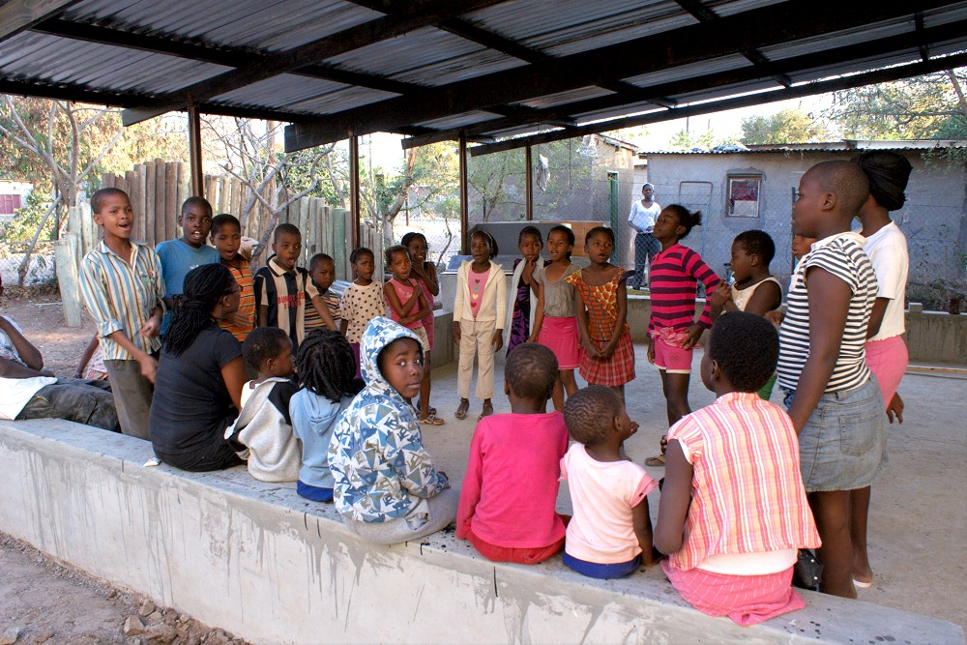
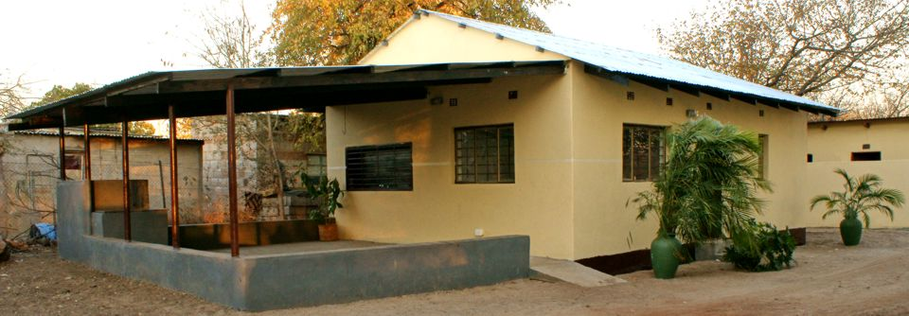
Facilities of Bana Ba Ditlou
Google Earth location
Toilets
Storage
Kitchen
Office
Office
BaBaDi facilities are small and simple. We often use some of the larger rooms of the Catholic mission church as well.
We have some ground to play near our place. Many children feel at home here.
menu

Slide 7
Sponsorship
Bana Ba Ditlou
Our facilities, maintenance, equipment, food for children, utilities, activities and wages for the staff are financed entirely by our sponsors.
If you like Bana Ba Ditlou (BaBaDi) project, please consider becoming our sponsor. Every dollar counts, and we promise you to use the funds with great responsibility, accountability and transparency for running and further development of the project.
All our Sponsors are listed on our website:
http://banabaditlou.homestead.com/sponsors.html
Please, visit our website for more information.
Tell other people about us.
Put a link on your website, write in your newsletter, magazine, blog, twitter, face-book
... simply help us to be known.
download our logo
menu

Slide 8
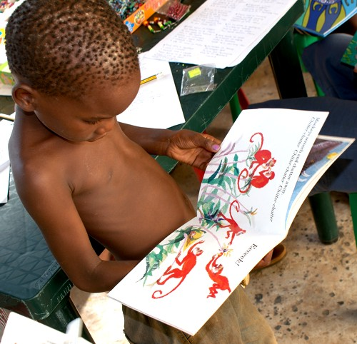
Donate to
Bana Ba Ditlou
As with other similar projects, we are struggling with funding.
Every, even smallest, donation counts and makes a difference in the life of children we try to help.
If you decide to make a donation, please contact us filling in the form on our website to arrange the transfer of funds.
Sponsor "small" concrete projects.
Donate for a very specific item.
The list of "small" projects – items that need funding - is on a special page of our website here.
menu

Slide 9
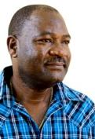
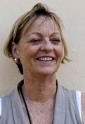
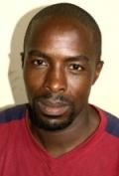
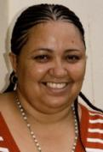
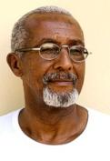
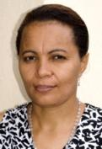
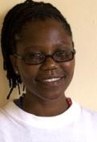
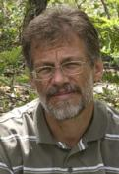
Dominic Judy Richard Cindy Michael Tracy Gobona Mareko
All members of the board are volunteers (except the coordinator – ex officio).
We are working towards establishing a trust (a very long legal process).
We are putting very strict policies in place guarding our project from an ’’NGO syndrome’’ (administrative overspending, loosing focus and the goal of the project – our children in need), and protecting our children from any kind of abuse, especially from the sexual abuse.
Board of Bana Ba Ditlou
menu

Slide 10
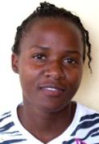
Staff of
Bana Ba Ditlou
Gobona
Coordinator
Tshitlo
Cook, helper
Currently we employ two staff members: the coordinator of the project and the cook, who is also an assistant of the coordinator. If our finances allow, we might consider employing yet another person.
The children are coming from early morning till the evening and they need to be supervised and kept busy.
Everyday we invite the members of the community to volunteer for few hours.
More and more people are interested to spend some time with our children.
menu

Slide 11
Contact
Bana Ba Ditlou
Postal address:
Bana Ba Ditlou
P.O. Box 579, Kasane,
Botswana, Africa
Internet address:
http://banabaditlou.homestead.com
Telephones:
(+267) 62 52 631 - Mission
(+267) 62 50 254 - Judy Hepburn
(+267) 72 19 14 72 - Fr. Mareko
E-mails:
banabaditlou@gmail.com
mareko.svd@info.bw
menu

Slide 12
Botswana is one of the few remaining places in Africa with vast areas of incredible wilderness and wildlife. It is a treasure that many people from around the world come to see. The country has become one of the prime safari destinations with booming tourism industry. And yet, on the fringes of these areas there are people, whom most of the visitors would never see, people of this country, owners and custodians of those wonders of nature.
However, many of them still do not benefit from the opportunities around them, especially many young people - out of school, unemployed, living in poverty and desperation, sometimes pushing them into prostitution, crime, alcohol and drug abuse, sexual irresponsibility and so often HIV-AIDS.
The true victims of this situation are children.
Most of them have never been to the national parks to see their fascinating animals. So, ’’why should they care about them, they are dangerous, they are for the rich and visitors...’’
We have recognised, already some years ago, that true conservation efforts must be always accompanied by social and development work among the local population.
By helping our children we are doing a long term conservation work, especially, if we help them to see the value of their animals, if we help them to own them and to appreciate them - among others, as a treasure and asset that might help many of them to have jobs in the future in the local tourism industry and necessary supporting services.
We want to expose our children to the beauty of nature as an aesthetic value and not just dangerous threatening reality and potential source of bush meat. We dream that some of our children would become best safari guides, biologists, ornithologists, herpetologists, officials of the Wildlife Department, nature photographers and filmmakers. We believe there is no better way to ensure the success of a long term conservation of natural resources in Botswana, in Africa.
menu
Conservation and Bana Ba Ditlou

Slide 13
Images of Bana Ba Ditlou
menu
1
2
3
4
5
6
7
8
9
10
11
12
13
14
15
16
17

Slide 14
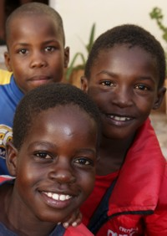
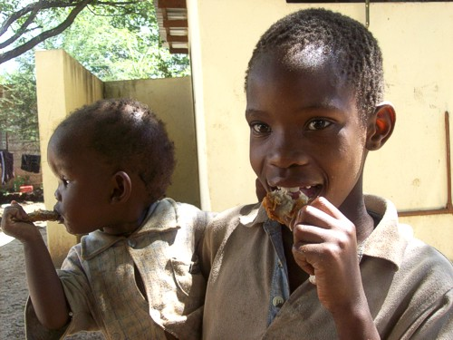
Some of our children are really hungry..., but not only for food...
menu
1
2
3
4
5
6
7
8
9
10
11
12
13
14
15
16
17

Slide 15
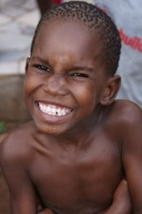
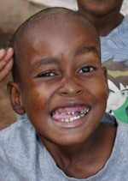
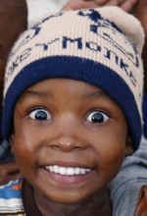
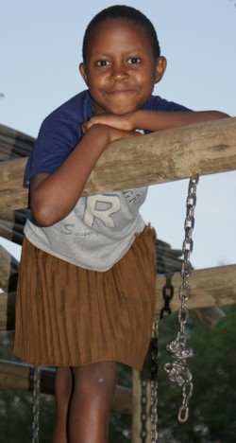
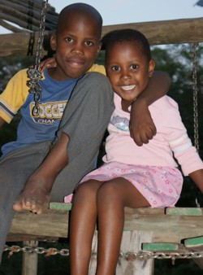
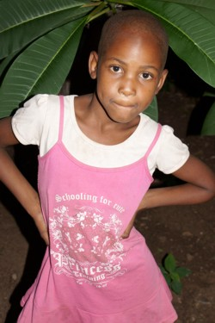
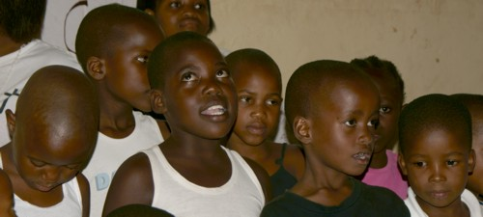
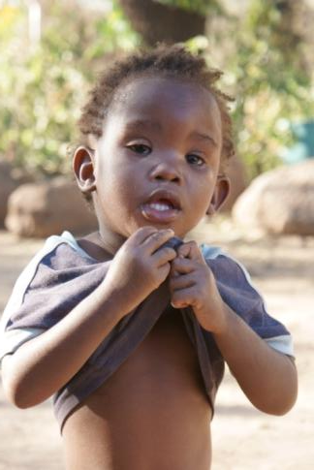
Images of Bana Ba Ditlou
Some of our children are real characters!
menu
1
2
3
4
5
6
7
8
9
10
11
12
13
14
15
16
17

Slide 16
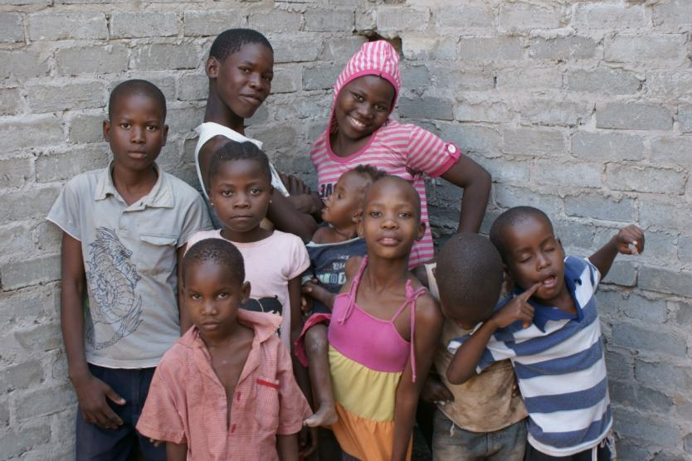
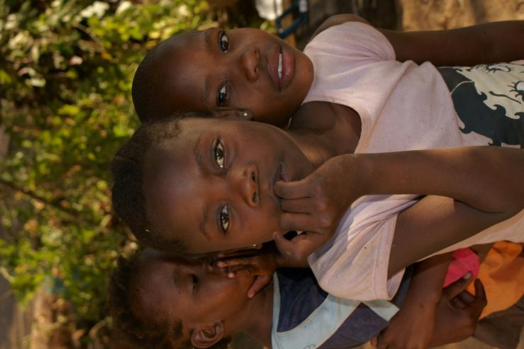
Most of the time they spent on the streets...
menu
1
2
3
4
5
6
7
8
9
10
11
12
13
14
15
16
17

Slide 17
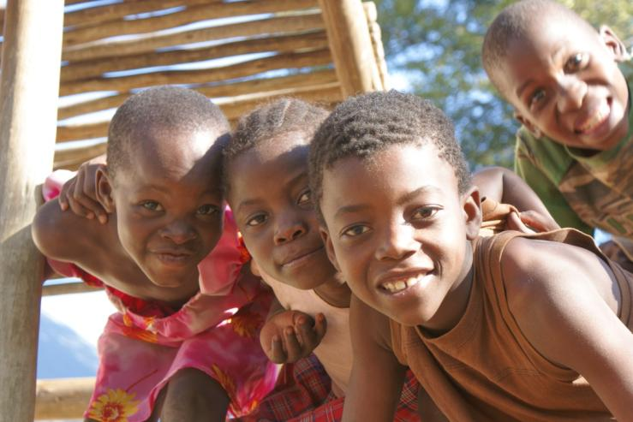
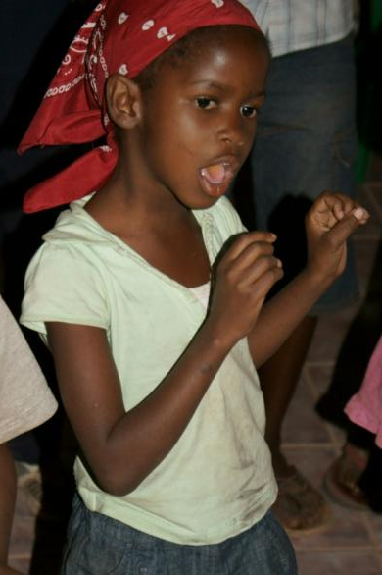
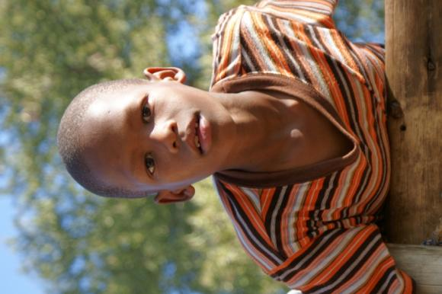
Many are bright and smart – but often they fail in school..., or worse – learn wrong things...
menu
1
2
3
4
5
6
7
8
9
10
11
12
13
14
15
16
17

Slide 18
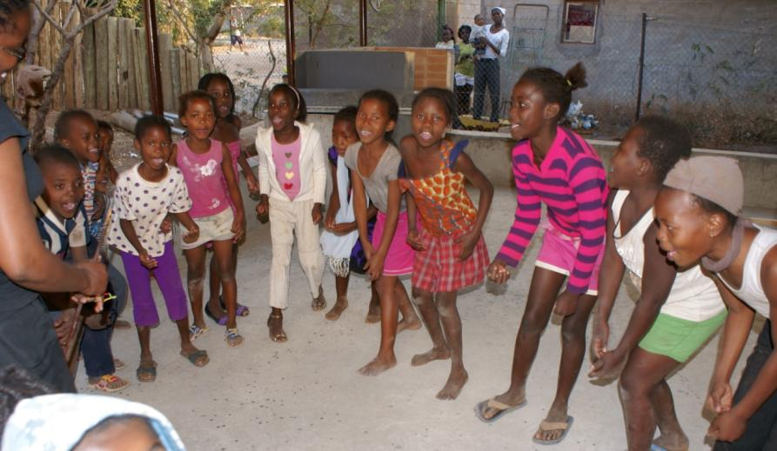
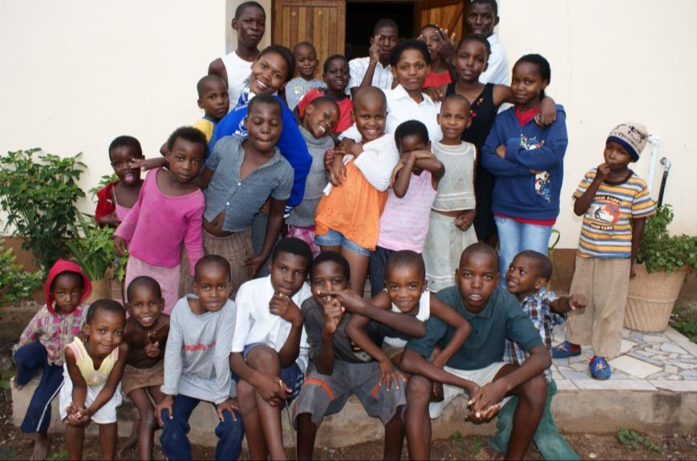
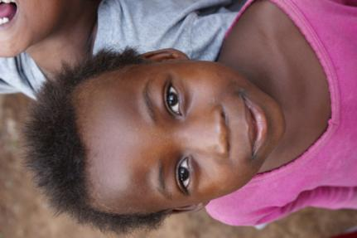
Given the chance they respond quickly,
they like doing things together.
menu
1
2
3
4
5
6
7
8
9
10
11
12
13
14
15
16
17

Slide 19
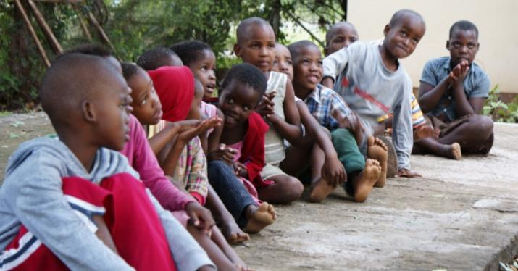
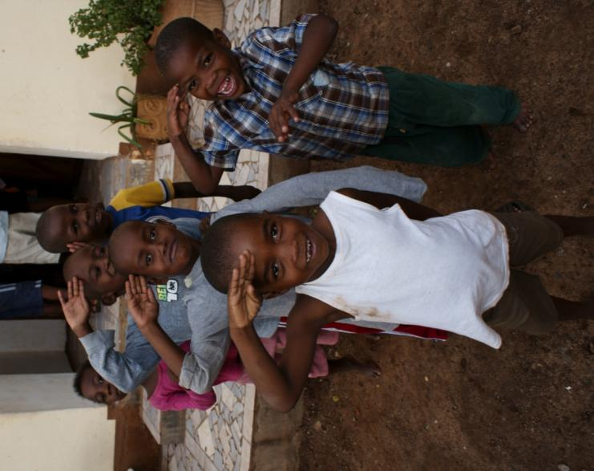
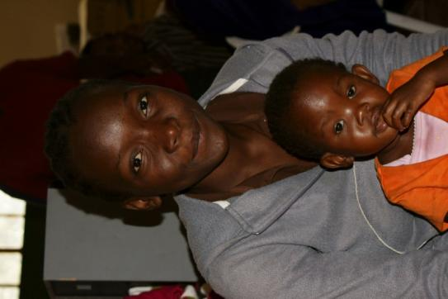
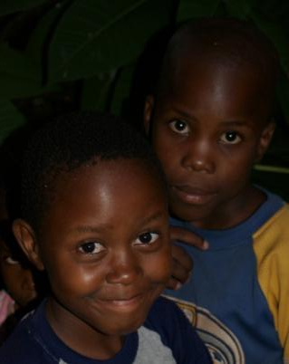
menu
1
2
3
4
5
6
7
8
9
10
11
12
13
14
15
16
17

Slide 20
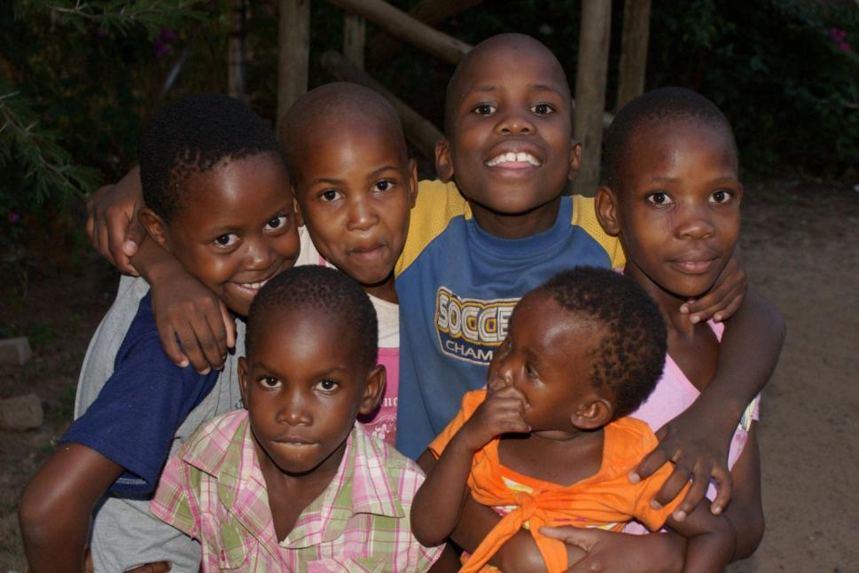
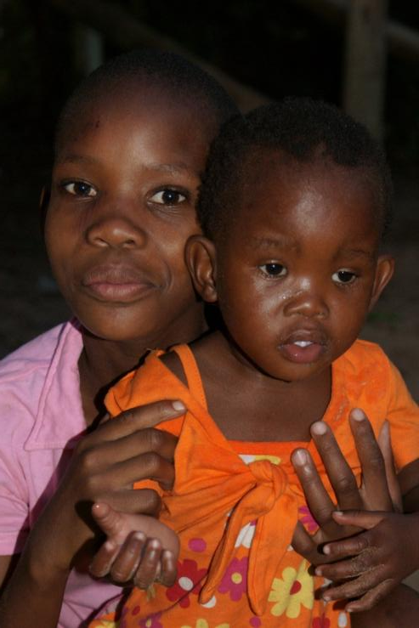
The 3 girls in front are sisters – orphans – reason for BaBaDi...
menu
1
2
3
4
5
6
7
8
9
10
11
12
13
14
15
16
17

Slide 21
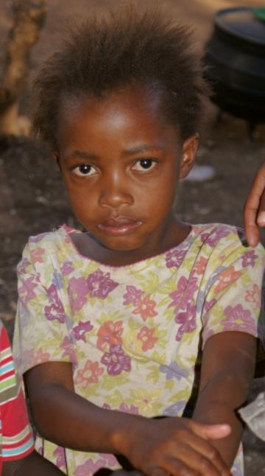
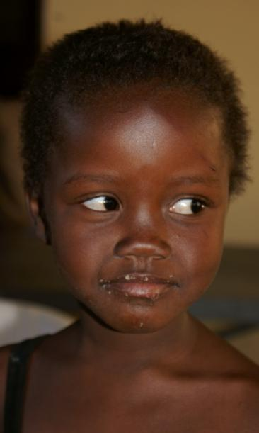
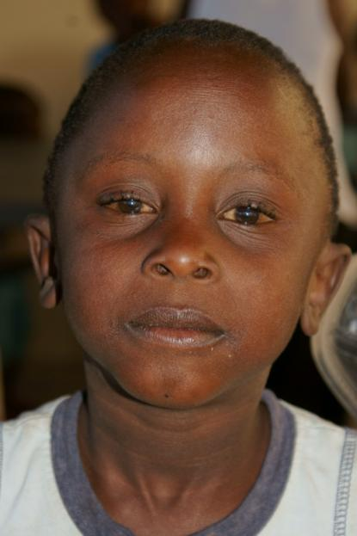
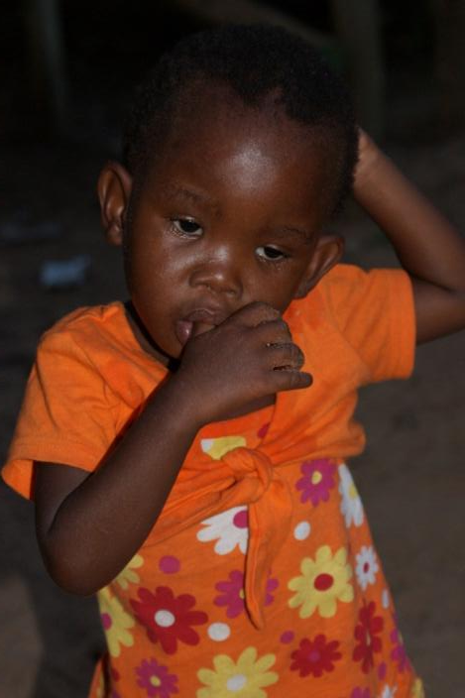
Some of our children are neglected, hungry, sick, even infected with HIV...
menu
1
2
3
4
5
6
7
8
9
10
11
12
13
14
15
16
17

Slide 22
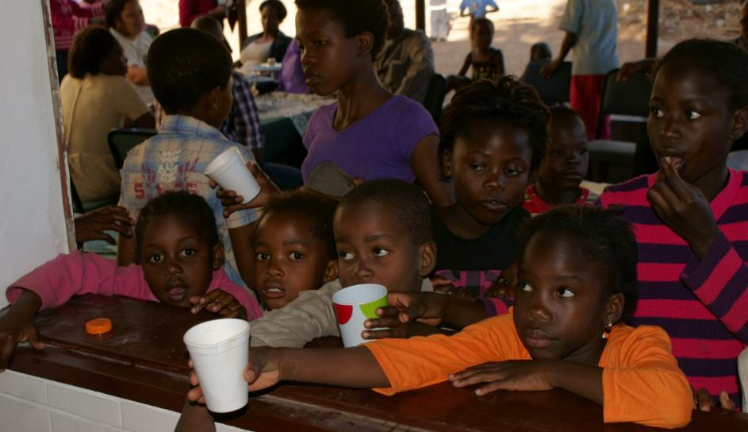
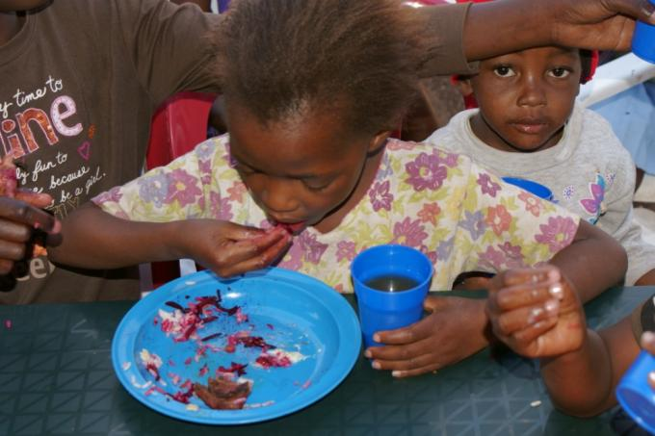
menu
1
2
3
4
5
6
7
8
9
10
11
12
13
14
15
16
17

Slide 23
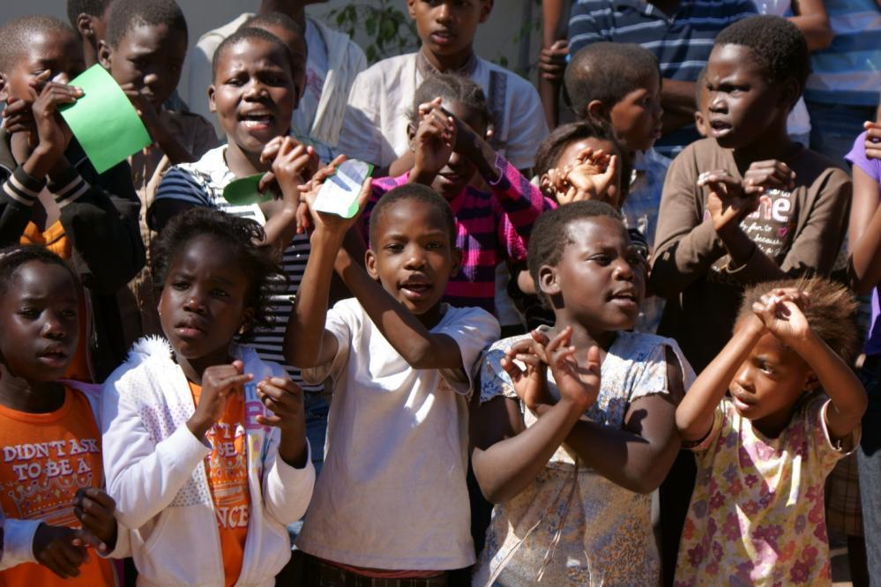
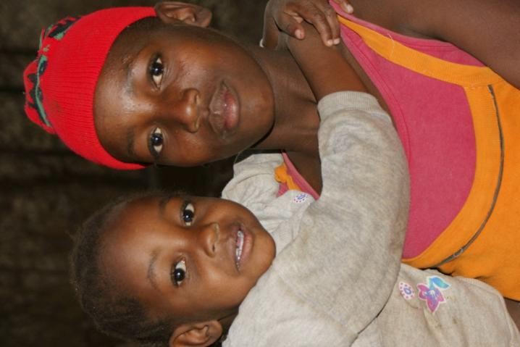
Images of Bana Ba Ditlou
menu
1
2
3
4
5
6
7
8
9
10
11
12
13
14
15
16
17

Slide 24
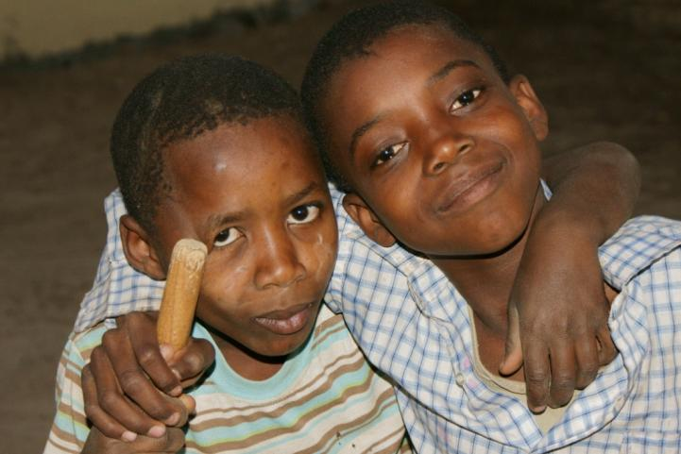
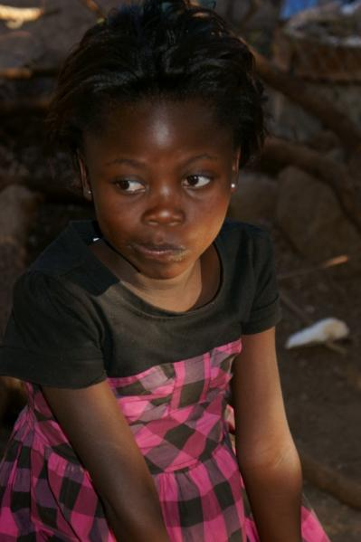
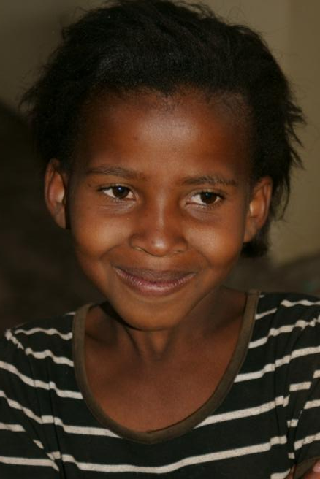
Images of Bana Ba Ditlou
menu
1
2
3
4
5
6
7
8
9
10
11
12
13
14
15
16
17

Slide 25
Images of Bana Ba Ditlou
menu
1
2
3
4
5
6
7
8
9
10
11
12
13
14
15
16
17

Slide 26
Images of Bana Ba Ditlou
Judy is well known by the children of Kasane.
It was her original idea to do something for those children – now a reality – BaBaDi.
menu
1
2
3
4
5
6
7
8
9
10
11
12
13
14
15
16
17

Slide 27
Images of Bana Ba Ditlou
Christmas Party 2010
Choir singing...
menu
1
2
3
4
5
6
7
8
9
10
11
12
13
14
15
16
17

Slide 28
Our volunteers helping and being happy with the children.
menu
1
2
3
4
5
6
7
8
9
10
11
12
13
14
15
16
17

Slide 29
We had a fun day for our children – and they had fun!
menu
1
2
3
4
5
6
7
8
9
10
11
12
13
14
15
16
17

Slide 30
Our children love sport and music. We need more equipment...
menu
1
2
3
4
5
6
7
8
9
10
11
12
13
14
15
16
17

Slide 31
Our children are living close
to a paradise but often
they don’t see it this way.
menu

Slide 32
Come on Safari
There are very few places on earth like Botswana,
– with huge wilderness areas,
still teeming with wildlife.
If you are interested to visit Botswana, please contact
Bona Safari Services
Botswana based travel agent & safari operator
supporting BaBaDi project with IT service, website,
and promotional (this CD) & educational materials.
menu

Slide 33
Expected impact and results of Bana Ba Ditlou (BaBaDi) project
It is difficult to predict the outcome of the project if it comes to numbers. We think that even if we could help and inspire just a dozen of children at any given time, we might help a lot of them in the long run. We hope to help especially those children that are in the most difficult social situation now. The results of this work will be immediately visible. However, the most important results of the project will not be very obvious initially, but the project might make a difference in the entire life of some of those children. If we manage to achieve that, the project will be successful.
We are also aware that once the project becomes known, other children, who are not necessarily in social need, but who stay nearby, will most probably come to be part of the activities of the BaBaDi project as well. This would be a welcomed development. As a principle therefore, the project will be opened to all children willing to come and participate in provided activities.
menu

Slide 34
In various ways the projects is supporting about 130 children at the moment.
There are many more children who need support in the area and we will slowly expand to cater for them.
We have to build the capacity first.
On regular basis there are about 50 children spending time in the premises of the project and are part of activities provided.
We indentified and screened 25 children who need regular feeding.
Many of them are not coming to the facilities of the BaBaDi Project yet, but we visit them and try to involve the social services to help them as well.
Presently we have 4 children who need regular food, who come to our project.
Bana Ba Ditlou
We are slowly developing different programmes for our children, trying to involve other organisations, businesses and volunteers. We hope that with the financial help from our sponsors, we will be able to improve our project and help many more children.
We need more sponsors, we need your support. Thank you for your interest and good heart.
May God bless you all. BaBaDi Team
menu

Slide 35
End of the presentation - Bana Ba Ditlou
Please, support Bana Ba Ditlou, support conservation based on social concern for the children
- future owners and guardians of Botswana’s incredible wilderness and wildlife.
Restart presentation
menu

